Slide 1


Dime Allies Hub
01

Slide 2

Problem
Today’s youth face three major financial challenges:
Unemployment and income instability make it difficult to plan financially.
Poor financial literacy leads to impulsive spending and poor money decisions.
Lack of disciplined saving habits undermines long-term goals like education, investments, or starting businesses.
10

Slide 3
Dime Allies’ Solution
A collaborative digital platform empowering youth with:
Peer-based financial education
Goal-oriented savings motivation
Real-time collaboration, resource sharing, and mentorship
Gamified tools like polls, chatrooms, events, and suggestion boards
06

Slide 4

Our Product
🗣️ Community Chatrooms – For financial discussions, tips, and accountability.
🧠 Polls & Suggestions – Get real-time feedback and advice from peers.
📄 Documents – Share saving guides, budgeting templates, and job links.
📅 Events – Join financial literacy webinars, job fairs, and community drives.
✅ Secure Authentication – Personal profiles and protected rooms for private collaboration.
04

Slide 5
Target Market
3 out 5
Youth suffers unemployment and income instability.
70%
Young people aged 18-30 are financially underserved in need of guidance.
15 Millions
Invest in UTT (Unit Trust of Tanzania) as a savings culture, offers to invest in privatized enterprises and capital markets.
14

Slide 6
Market Size
Young people aged 18–30, especially in:
University students or early employment stages
About 64% are Tanzanian youth, wanting community-driven, relatable solutions—not corporate advice.
Over 70% of the population under 30 in Tanzania, are actively engaged with technology.

Slide 7
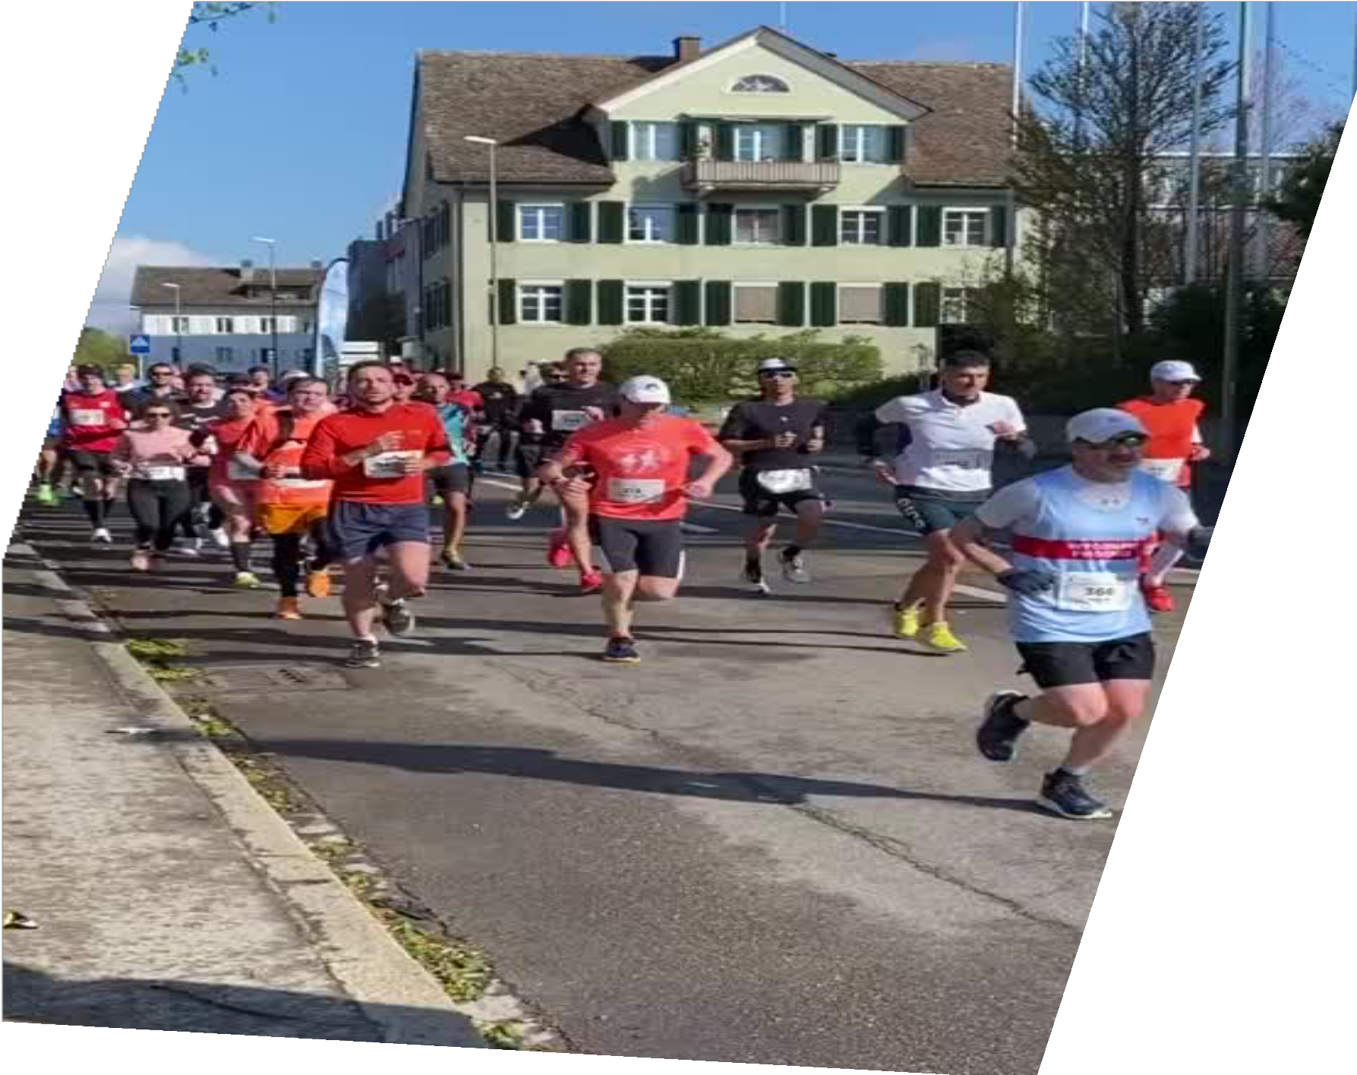
Competitors
SACOS
VIKOBA
WhatsApp Groups
Students Financial Aid Startups
23

Slide 8
Competitive Advantage
Transparent and honest platform
Structured engagement
Real-time collaboration, socializing and supporting our own on happy and sad occasions.
Utilization UTT benefits of private sectors investments and capital markets.
Gamified tools like polls, chatrooms, events, and suggestion boards.

Slide 9
Project Traction
Tasks
Month 1
Month 2
Month 3
Month 4
Month 5
Conducted Market research have members joined
Defined product features
Begin development
Conducts integration testing with the available members
Launch MVP of the app
Monitor and analyze user engagement
23

Slide 10
Business Model
Entry fee: Every new member has to pay an entry fee to join with us.
Partner Organizations: Startups, or education hubs sponsor .
Fines and Interests from Loans: There are rules guiding, so fine are generated and our Group provides loans in return there is an interest of 20% per month.
UTT: monthly profit which is about 13% of the invested money
23

Slide 11
Go To Market
🤝 UTT partnerships
📱 Social media student influencer campaigns
🏫 Orientation week onboarding demos
🧑‍🏫 Financial literacy NGO collaborations

Slide 12
Social Impact
SDG 4: Quality Education
SDG 8: Decent Work and Economic Growth
SDG 10: Reduced Inequalities

Slide 13
Our Ask
We are seeking $10,000 – $15,000 to:
Develop and deploy a robust mobile application
Integrate advanced analytics for personalized financial insights
Establish strategic partnerships with financial literacy organizations for expert mentorship and coaching
Execute targeted youth-focused marketing campaigns to expand our reach and impact
This support will empower us to provide reliable, relatable, and expert-backed financial guidance to underserved youth—helping them build a better financial future today.

Slide 14

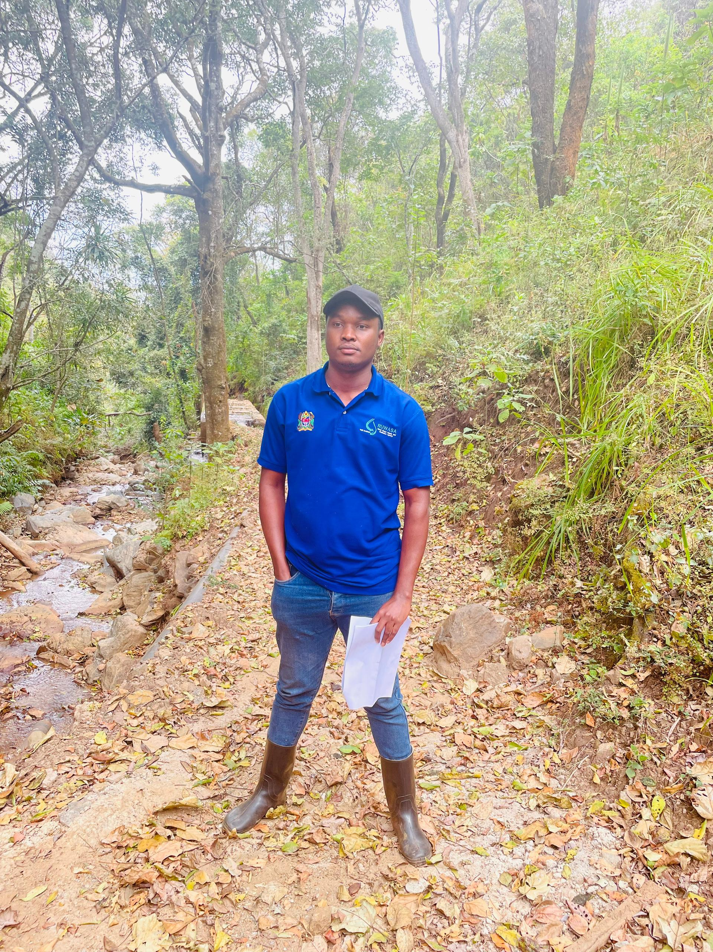

Team Members
LUTFIA MOSI
Developer , Vision Lead & Chairperson
OBADIA SAMA
Coordinator & Operations Lead
SWAUMU MFAUME
Treasury & Finance Handler

Slide 15
Thank you!
Email-dimeallieshub@gmail.com
Email: lutfikhatib112@gmail.com
Contacts: +255 656 936 620
+255 745 630 106
+255 718 126 212
17

